Slide 1
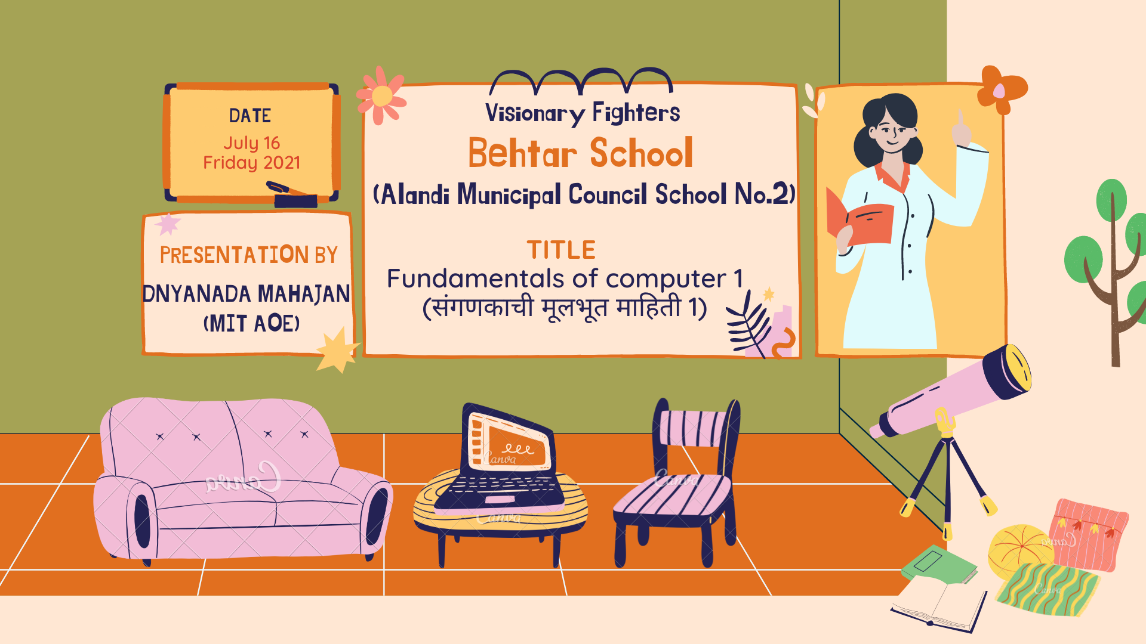

Slide 2
FUNDAMENTALS OF COMPUTER

Slide 3
Computer is an electronic device that accepts the data, stores data, processes the data and then produces a result.
A computer is made up of hardware and software components, while hardware components include input and output devices.
Computer is made up of:
Hardware components
software components

Slide 4
01
HARDWARDE COMPONENETS

Slide 5
The components of a computer which can be seen or which can be touched are called hardware components.
eg- monitor, CPU, keyboard, etc.
Hardware components consist of:
Input devices
Output devices

Slide 6
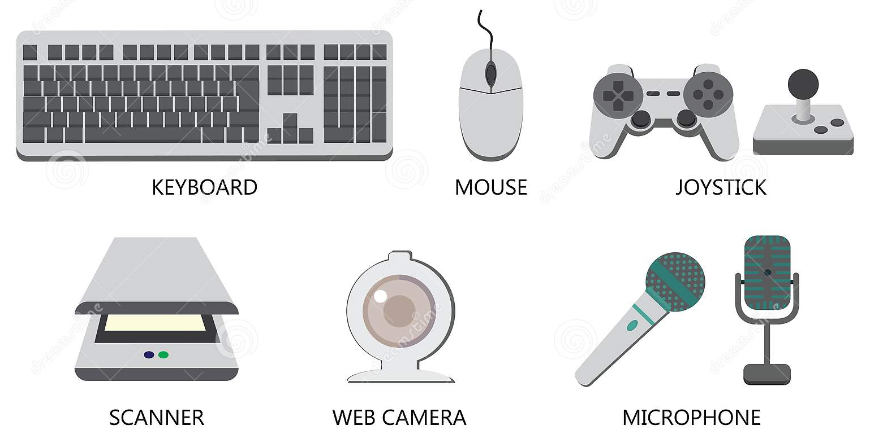
Input devices
A device through which data is entered in the computer is called as input devices.
eg- keyboard, mouse, scanner, microphone, web camera.

Slide 7
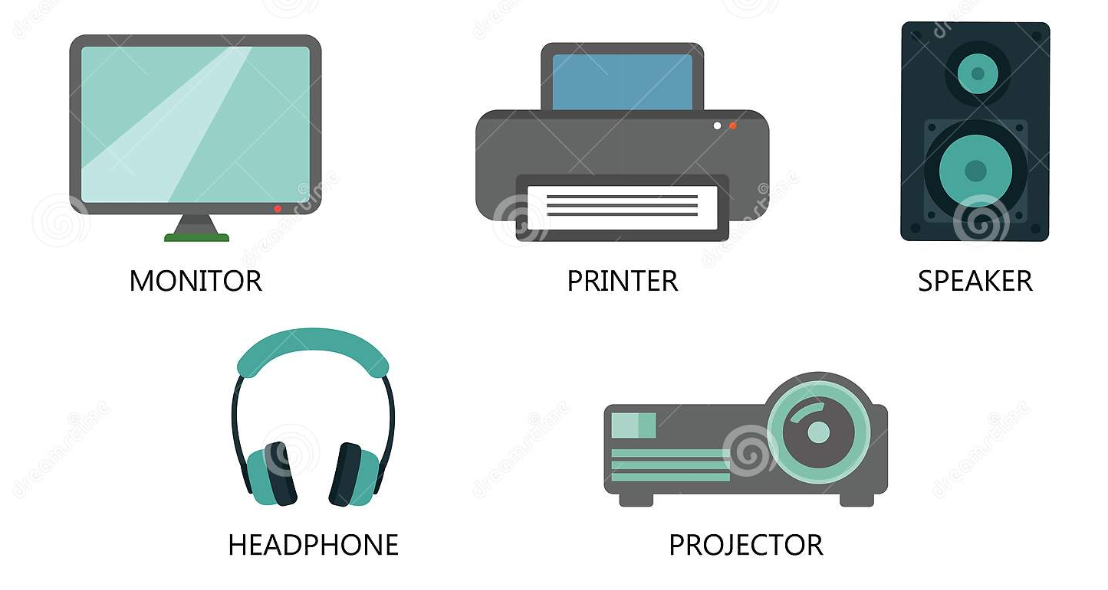
Output devices
A device that allows the user to see the information generated by a computer is called as output devices.
eg- mointer, printer, speaker, headphone, projector.

Slide 8
02
SOFTWARE COMPONENETS

Slide 9
The software a set of instructions on which a computer works. We cannot touch the software but it can be seen in form of symbols if installed in computer.
eg- MS-Dos, etc.
There are two types of software:
System software
Application software

Slide 10



System software
It is already stored on hard-disk of computer.
It controls, organizes and manages operations of a computer.
It enables us to intreact with the computer language.
eg- Mac-OS, Linux, Microsoft windows.

Slide 11
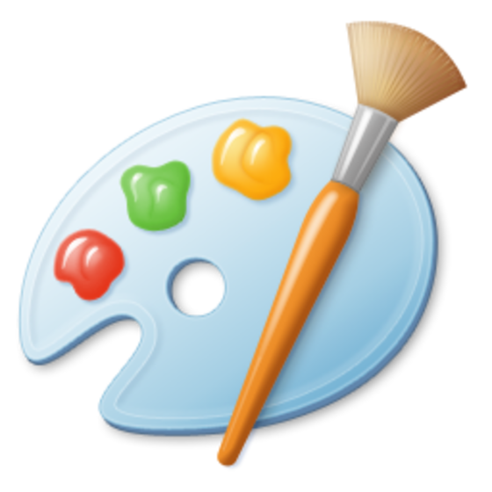



Application software
Application software performs certain tasks with the help of the operating system.
For example – typing a letter, performing calculations, palying games, etc
Paint, MS word, Powerpoint, Excel are examples of application software.

Slide 12
03
PARTS OF COMPUTER

Slide 13
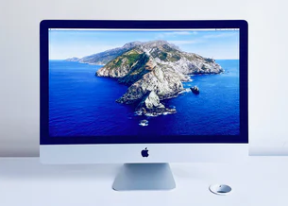
Monitor
The device which looks like a TV screen is called a monitor
Whenever text is typed on keyboard it appears on the screen of monitor

Slide 14
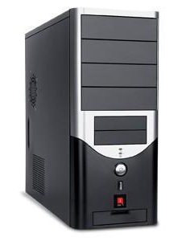
CPU (Central Processing Unit)
It cares out all primary functions of a computer.
The CPU receives instructions from both the active software and hardware.
CPU helps input and output devices to communicate with one another.
Hence, CPU is also known as brain of computer.
It consist of three significant parts:
Storage unit or memory.
Control unit.
ALU (Arithmetic Logic Unit).

Slide 15
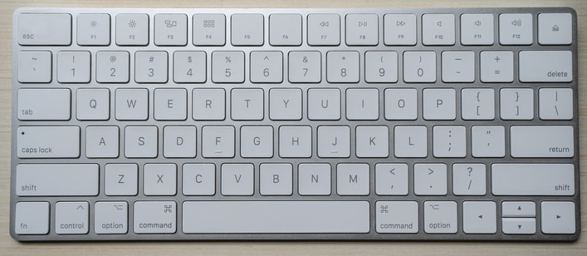
Keyboard
A keyboard is a flat rectangular board having several buttons called keys.
A user can enter data into computer through keyboard.
There are different keys present on the computer

Slide 16
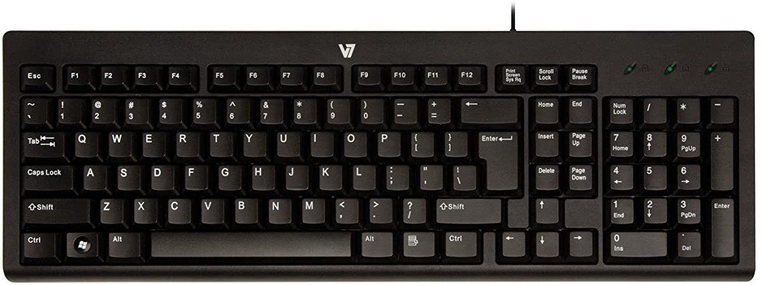
Caps-lock key
Keys present on keyboard:
Escape key
Backspace key
Number keys
Shift key
Arrow keys
Control key
Space key
Enter key

Slide 17
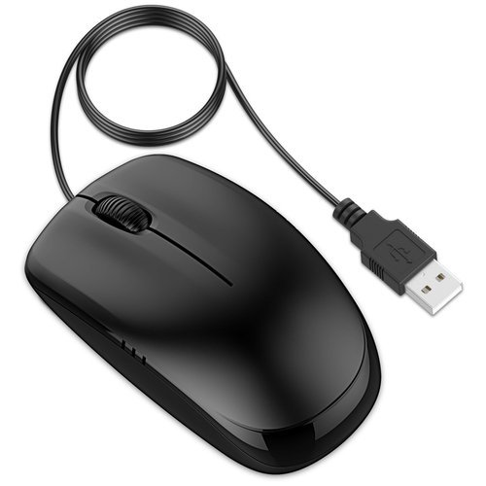
Mouse
A mouse is a hand operated input device which is used to move the position of a cursor on a screen .
When you press a button on mouse it is called click.
If you click a button twice then it is called double-click.

Slide 18
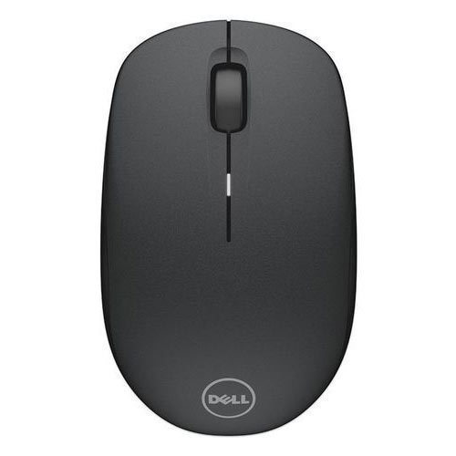
Keys present on mouse:
Right click
Left click
Scroll

Slide 19
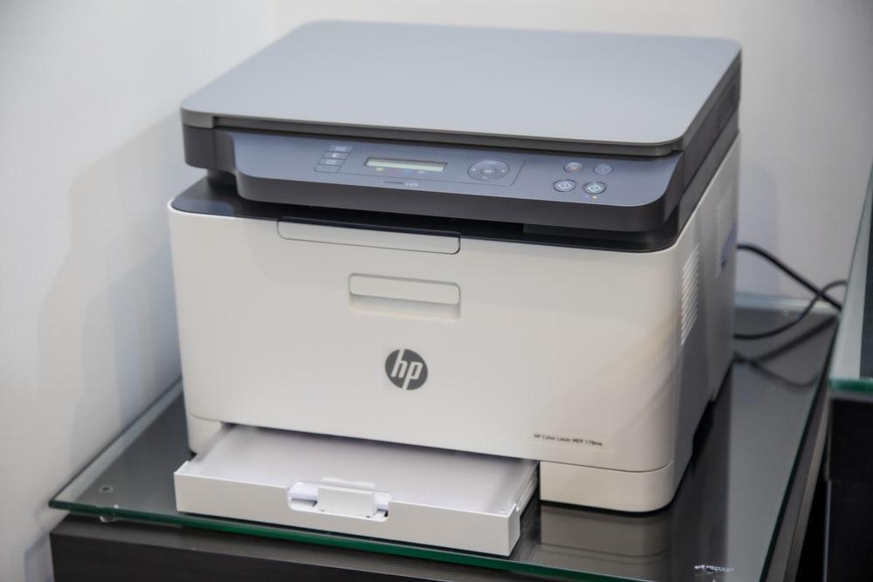
Scanner
It is a peripheral part which is attached to the computer whenever required.
The scanner allows you to capture documents that are printed on paper and turn them into digital form so that we can view it on computer.

Slide 20
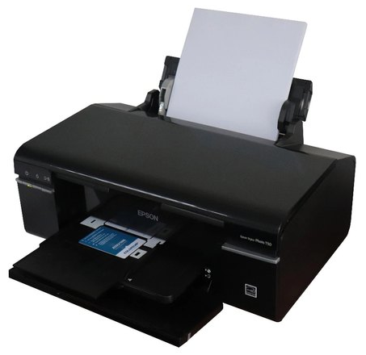
Printer
The output seen on a computer can be printed on paper the the help of a printer.
It is also a peripheral part which is attached to the computer whenever required.

Slide 21
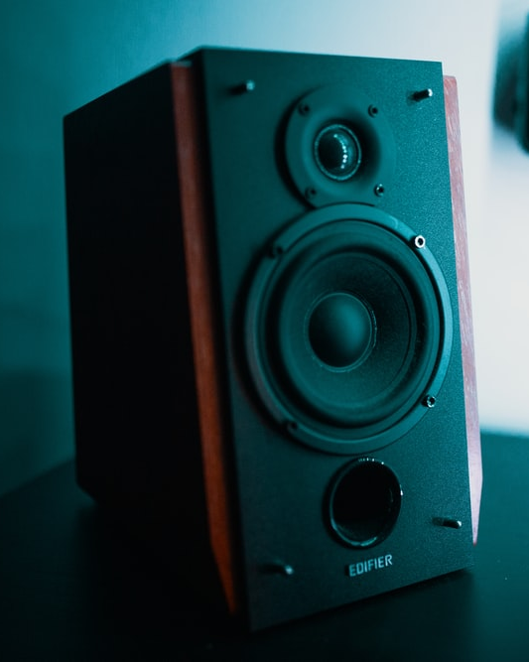
Speaker
Speaker gives the result in the form of sound which we can hear.
Speakers contain amplifiers which vibrate to produce the sound.
They come in many different forms.
Some speakers are already attached to a computer. Some speakers are wireless.

Slide 22
04
STORAGE DEVICES

Slide 23
Storage devices are used to store information for a long duration of time.
There are two types of storage :
Primary storage
Secondary storage

Slide 24
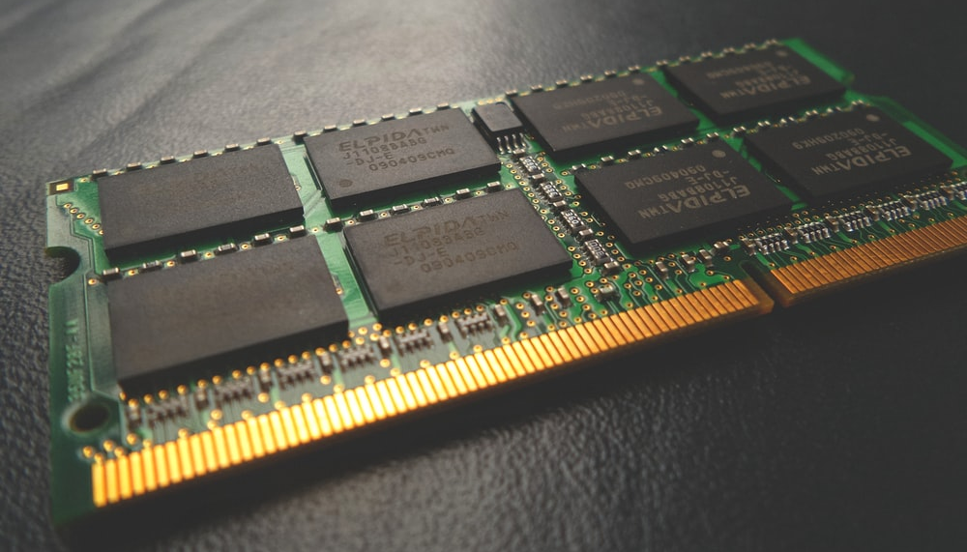
Primary storage
Primary storage (also known as main memory) is the component of the computer that hold data, programs and instructions that are currently in use.
Primary storage includes random access memory (RAM), read only memory (ROM).
ROM is a non-volatile (keeps its contents even when the computer is switched off) type of memory while RAM is volatile (loses its contents when power is lost)

Slide 25
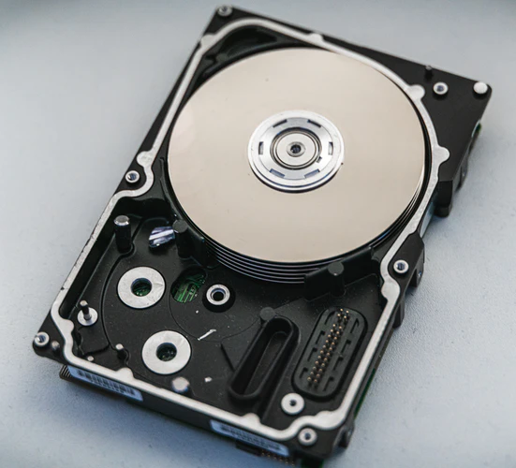
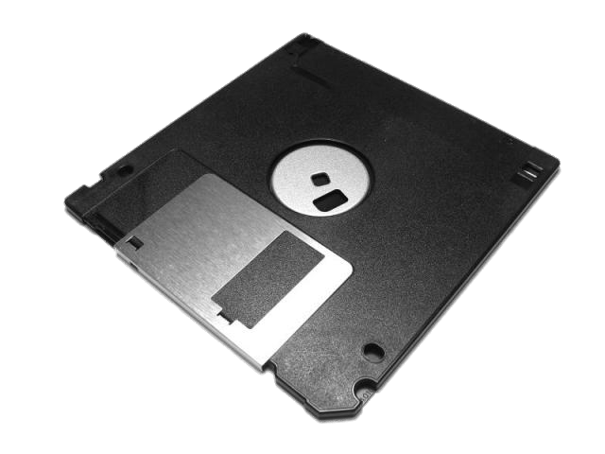
Secondary storage
The secondary storage devices are used to store data permanently even when computer is switched off.
Three secondary storage devices are:
Hard-disk – On a hard disk, information is stored permanently. It is completely sealed and built inside a CPU.
Floppy disk – It is used to transfer data from one computer to another.

Slide 26
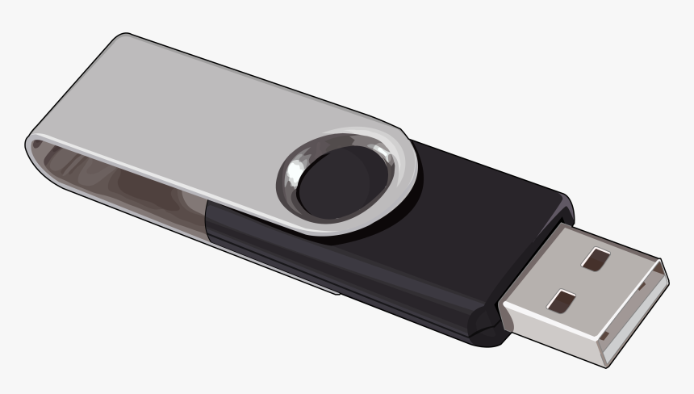
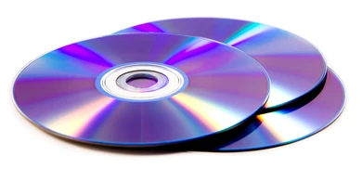
CD-ROM – It is a circular-shaped disk which can store data more than floppy but less than hard-disk.
Pen drive - Commonly known as a USB flash drive it is a portable device which means it can be easily transferred from one location to another due to its compact design it looks like a pen shape and therefore it is named a pen drive.

Slide 27
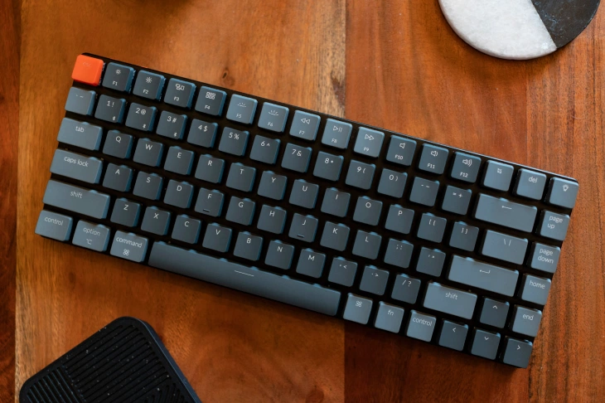
Questions
Identify the object in the image
Printer
Scanner
Keyboard
Monitor
Answer:- Keyboard

Slide 28
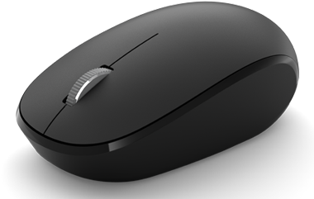
Questions
Identify the object in the image
CPU
Microphone
Mouse
Speaker
Answer:- Mouse

Slide 29
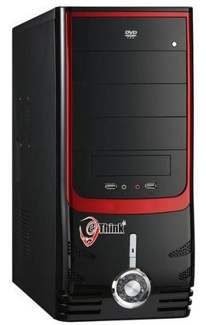
Questions
What is full form of CPU?
A. Central Process Unit
B. Central Processing Unit
C. Central Programming Unit
D. Central Progressive Unit
Answer:- Central Processing Unit

Slide 30


